Slide 1


Department of Information Technology
V R Siddhartha Engineering College
AL-BASED BLOOD DONATION &
MATCHING SYSTEM
B.Tech in Information Technology Major Project Review Presentation
Presented by: Mr.Banavath Rohith Nayak(228W1A12D5) Ms. Nenavath Sai Amrutha (228W1A12H6)
Under the guidance of Pandala Madhavi Latha, Assistant Professor.

Slide 2
Agenda
Motivation and Problem statement
Objectives and Outcomes of the Project
Literature Survey
Datasets and Requirements Specifications
Algorithms used in the Project
Architecture Diagram
Complete Results obtained
Conclusion & Future work
References

Slide 3
.
INTRODUCTION
Blood donation is essential for saving lives during emergencies, but delays in finding available blood and suitable donors can lead to critical situations.
Existing systems mainly store donor information but lack real-time updates and intelligent matching, making the process slow and inefficient.
The AI-Based Blood Donation & Matching System uses artificial intelligence to quickly identify compatible donors and available blood, improving response time and enhancing emergency healthcare support.

Slide 4
.
PROBLEM STATEMENT
Lack of real-time visibility of blood availability and donor information leads to critical delays during medical emergencies.
Traditional systems are fragmented and do not provide efficient or intelligent matching of donors with recipients.
The AI-Based Blood Donation & Matching System provides a centralized platform with real-time updates on blood stock and donor availability.
It uses AI-based matching to quickly identify suitable donors based on blood group, location, and urgency, improving emergency response and saving lives.

Slide 5
OBJECTIVES
To develop a real-time digital platform that connects donors, hospitals, and blood centres efficiently.
To provide real-time information on blood availability and donor details.
To implement AI-based matching for quick and accurate donor identification.
To improve coordination between donors, hospitals, and blood banks.
OUTCOMES
Faster and more reliable access to blood during emergencies.
Reduced response time through smart donor matching.
Improved efficiency and centralized management of blood donation services.

Slide 6
Literature summary
Name | Year | Work done | Technologies used | Conclusion
AI-Driven Blood Bank Management System | 2025 | Used AI to predict blood demand and optimize donor matching. | MachineLearning, Python | AI improves prediction accuracy and helps maintain optimal blood stock
Comprehensive Blood BankManagement System | 2024 | Automated donor management, blood stock tracking, and hospital requests | Web-based system, MySQL Database | Automation helps in real-time availability and better donor coordination
Web-Based Blood Bank Management System | 2024 | Developed an online platform for donor search and blood requests | Python Django, SQLite/MySQL | Web systems provide faster communication between donors and hospitals.

Slide 7
Literature summary
Name | Year | Work done | Technologies used | Conclusion
E-Blood Bank Monitoring System. | 2024 | Introduced,digital monitoring of blood stock with alerts. | IoT, Cloud Computing | Real-time monitoring reduces blood wastage and shortages
SmartMonitoring, Management, and Control ofBloodBank Management System Using IoT | 2023 | Proposed an IoT-based system to monitor blood bank operations, track blood availability, and automate stock management. | IoT, cloud services, database management | The system ensures real-time monitoring, reduces manual errors, and improves efficiency in blood bank operations.
Centralized Blood Bank Management System | 2024 | Created a centralized database for multiple hospitals. | PHP, MySQL, Web Service | Centralized systems improve coordination and availability across regions

Slide 8
DATASETS
Donor Dataset– ID, Name, Contact, Blood Group, Location, Availability, Last Donation Date, Eligibility Status..
Inventory Dataset – Blood Group, Units Available, Expiry Date, Storage Location, Last Updated.
Request Dataset – Request ID, Patient Info, Required Blood Group, Units Needed, Urgency Level, Location.
Notification Dataset – Alert ID, Message, Trigger Type, Date Sent, Status.
User Dataset – User ID, Role, Login Details, Permissions.
Emergency Alert Dataset – Alert ID, Donor ID, Blood Group, Location, Message, Alert Type (SMS/Email), Date Sent, Status.

Slide 9
REQUIREMENTS
Frontend: Flutter / React Native.
Backend: Node.js / Firebase.
Database: Firebase Firestore / MySQL.
APIs: Google Maps API, Firebase Cloud Messaging.
AI Module: Rule-Based Matching System, Emergency AI Donor Matching.

Slide 10
ALGORITHMS
Donor Registration & Eligibility Validation – Verifies donor details, health criteria, and last donation date before approval.
Inventory Management Algorithm – Updates blood stock automatically and monitors expiry dates in real time.
Request Processing Algorithm – Matches patient requests with available blood units and updates status instant.
Low-Stock Alert & Notification Algorithm – Sends automatic alerts to admins and donors when stock levels fall below the threshold.
AI-Based Emergency Donor Matching-Uses Decision Tree and rule-based logic to filter and prioritize donors on blood group, location,availability,and urgrncy level.

Slide 11
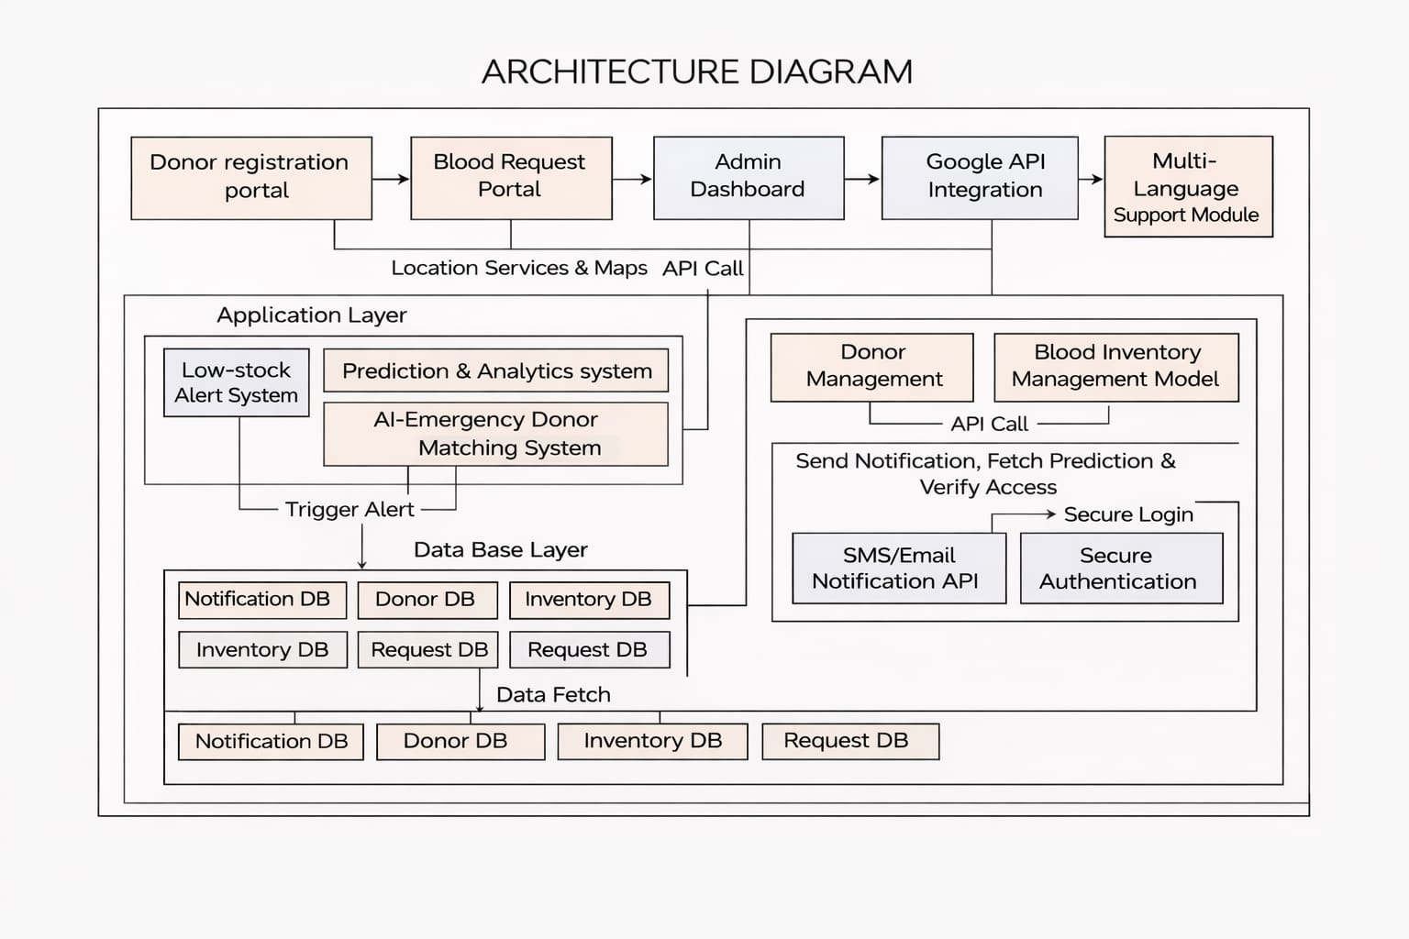
ARCHITECTURE DIAGRAM

Slide 12
IMPLEMENTATION STEPS
1.Data Collection
Collected donor details, blood groups, and blood bank inventory dataIncluded eligibility parameters like age, health status, and last donation.
Included eligibility parameters like age, health status, and last donation.
Donor details (Name, Age, Blood Group, Location, Contact)
Eligibility parameters (Last donation date, Health status)
2. Data Preprocessing
Cleaned and standardized donor and blood dataHandled missing values and converted data for model use.
Handled missing values and converted data for model use.
Removed duplicate and invalid donor records
3. System Development
Developed modules for donor registration and inventory tracking.
Implemented AI-based matching and emergency request system.

Slide 13
4. Model TrainingUsed
Trained model for eligibility prediction and compatibility check.
5. AI IntegrationImplemented
Implemented smart donor matching based on location and availability
Enabled automated alerts for emergency blood requests
Blood compatibilityDistance/locationAvailability statusAutomated notification system (SMS/Email alerts)
7. Final Output
Available blood units in nearby banks
List of matched donors
Emergency alerts and notifications
Provides real-time response for blood requests

Slide 14
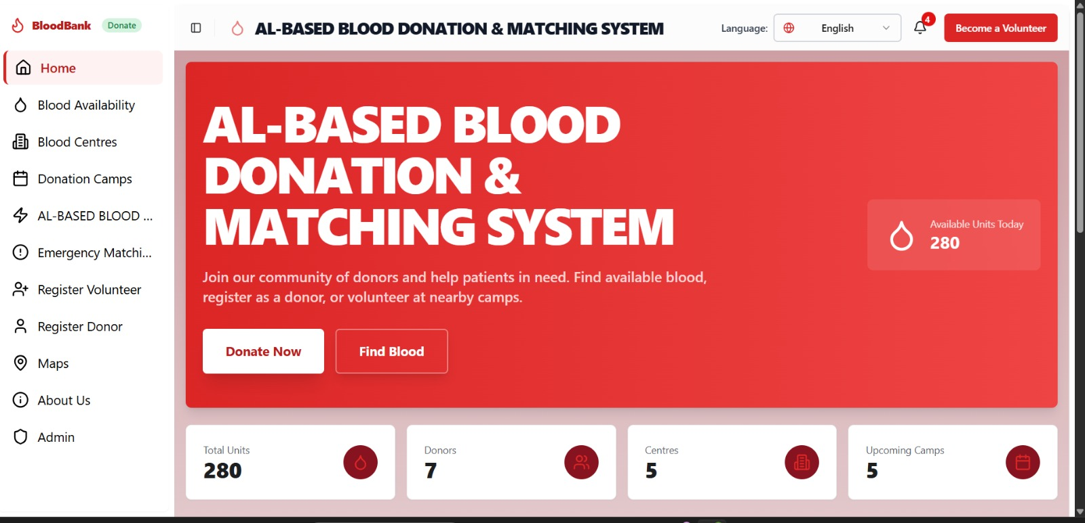
RESULTS ANALYSIS
.
DASHBOARD

Slide 15
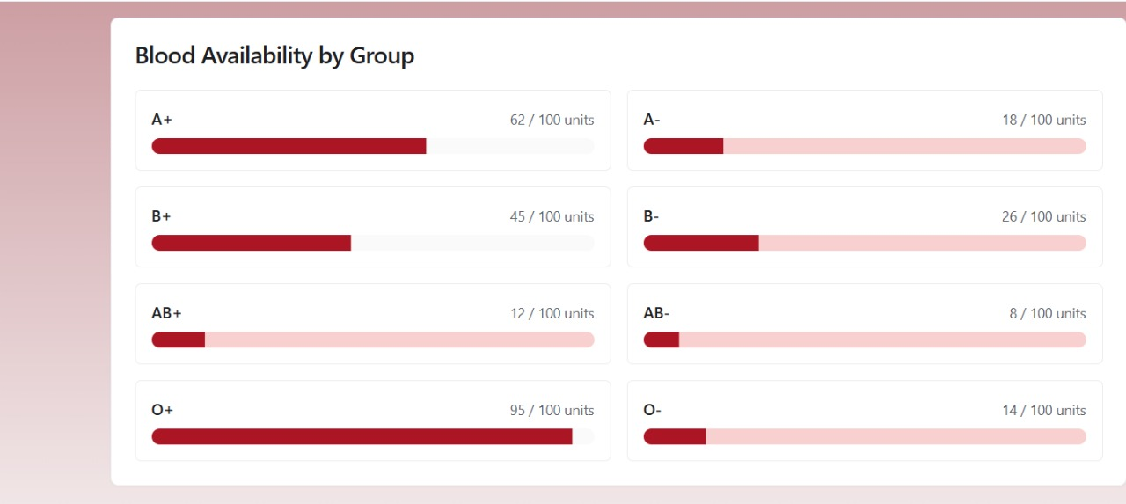
RESULTS
BLOOD AVAILABILITY

Slide 16
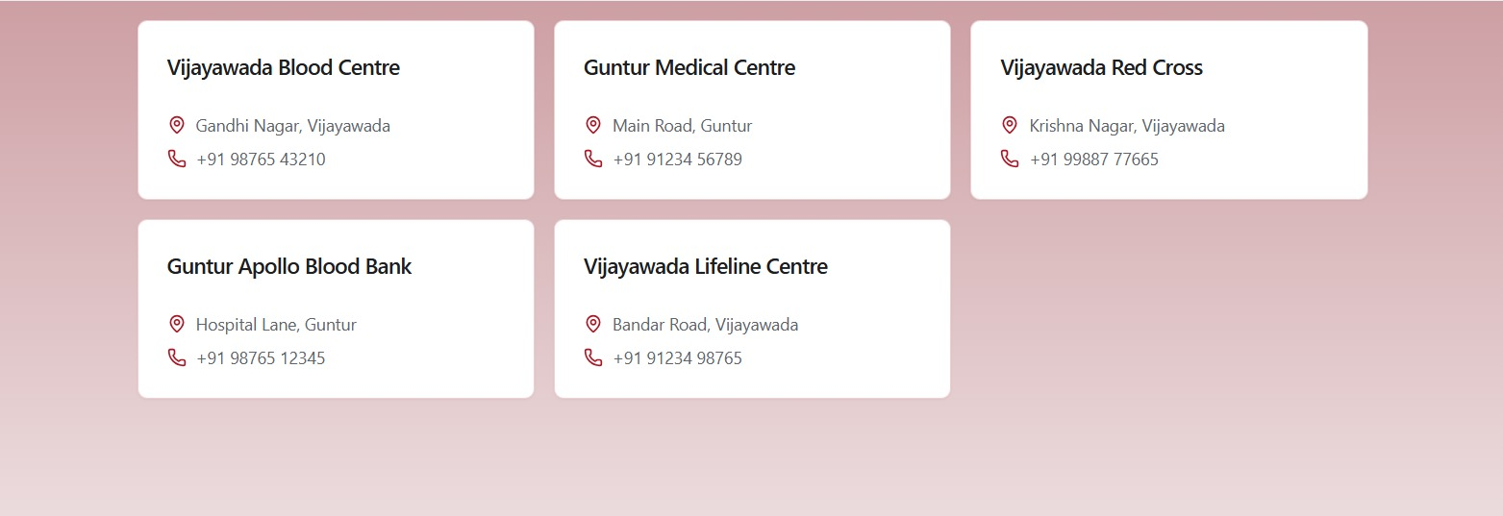
BLOOD CENTRE

Slide 17
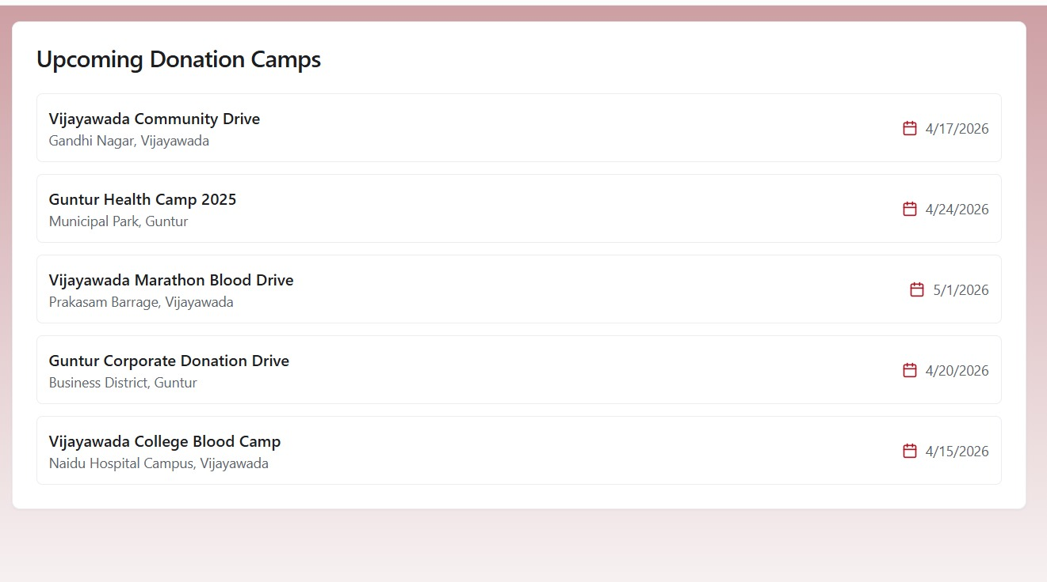
BLOOD DONATION CAMPS

Slide 18
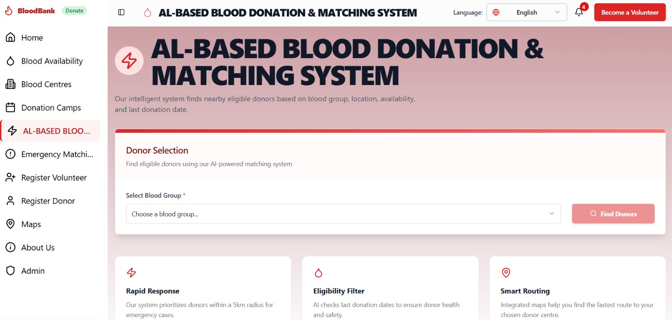
AL-BASED BLOOD MATCHING SYSTEM

Slide 19
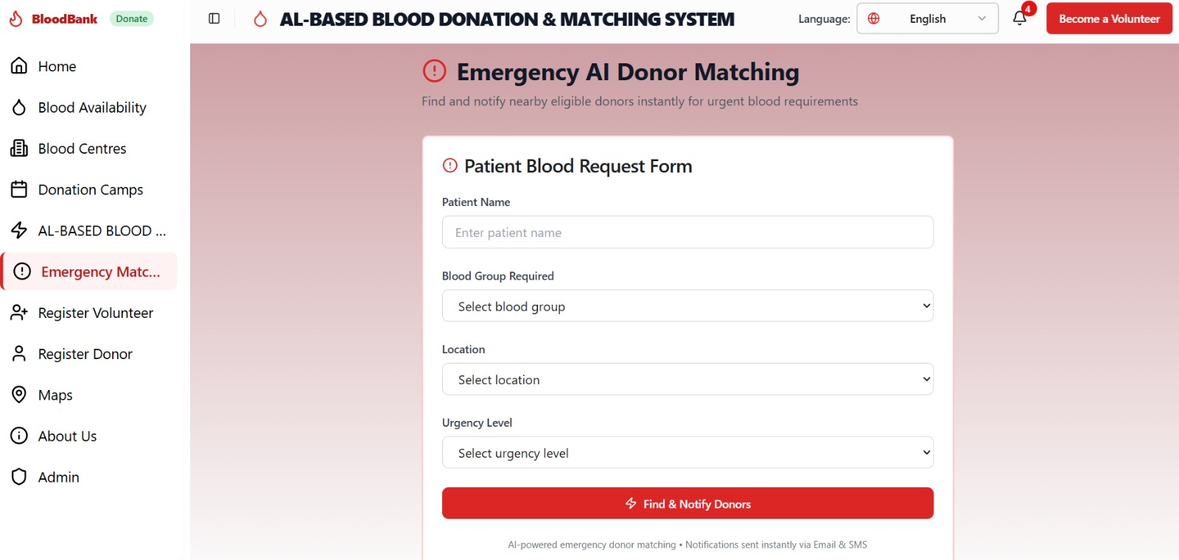
Emergency AI Donor Matching

Slide 20
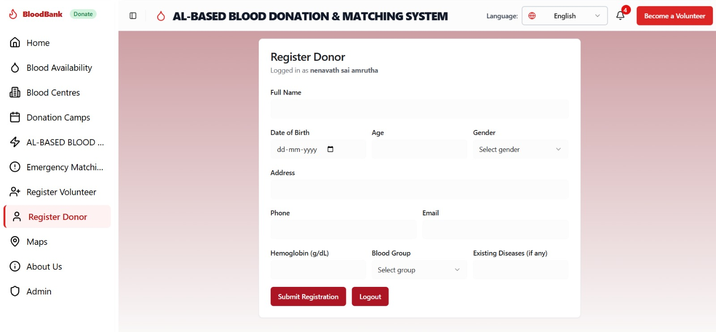
DONOR REGISTRATION FORM

Slide 21
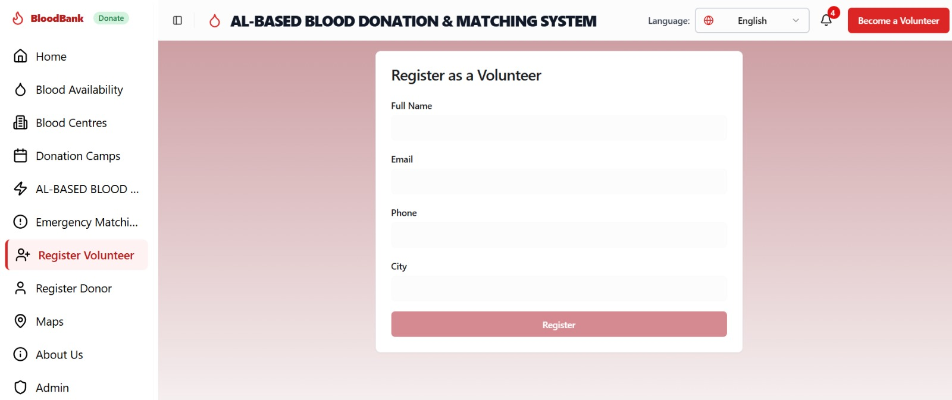
REGISTER AS A VOLUNTEER

Slide 22
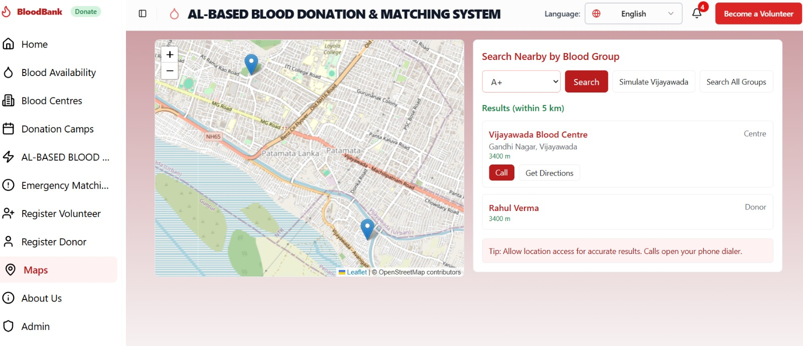
MAPS

Slide 23
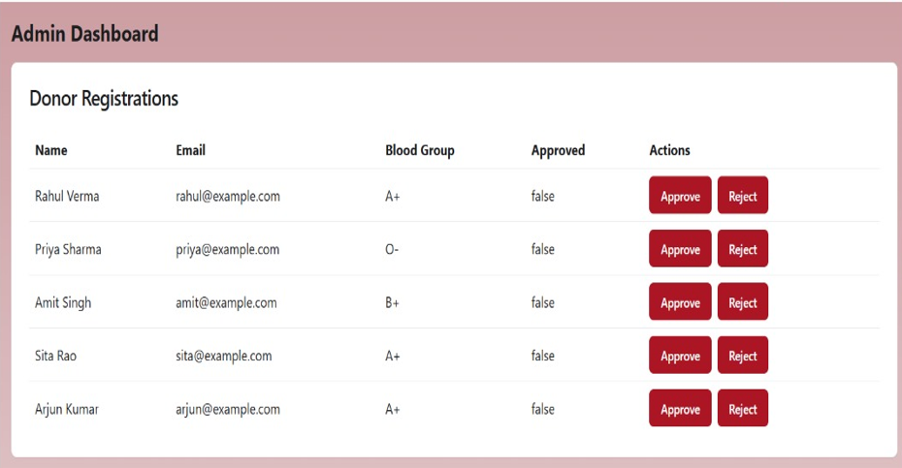
ADMIN DASHBOARD

Slide 24
RESULT ANALYSIS
System ensured reliable and real-time blood availability tracking.
Reduced delay in emergency blood requests.
Improved accuracy in donor eligibility verification.
Faster identification of rare blood groups.
Location-based matching minimized response time.
Automated alerts increased donor participation.
System reduced manual errors and data redundancy.
Scalable for multiple hospitals and blood banks.
Consistent performance under high user load.

Slide 25
ARCHITECTURE DIAGRAM

Slide 26
CONCLUSION
.
The system provides a centralized and automated platform for managing blood donation and requests efficiently.
It improves transparency and real-time tracking of blood inventory and donor information.
It reduces delays and manual effort, helping in saving lives during emergencies.
It ensures better utilization of blood units by minimizing wastage and managing expiry effectively.
It enhances communication between donors, hospitals, and blood banks through notifications.

Slide 27
FUTURE WORK
.
Mobile Application Development: Develop Android/iOS apps for easy access, real-time notifications, and location-based services.
Integration with Hospitals: Connect directly with hospital databases and government health systems for seamless data sharing.
Real-Time GPS Tracking: Enhance emergency donor matching with live location tracking and route optimization.
Chatbot Support: Add AI chatbots to assist users with queries, registration, and emergency.

Slide 28
References
[1]Patil, Sakshi & Taral, Swaroop & Satpute, Vedant & Kadam, Viresh & Sharma, Yogesh. (2023). "Blood Bank Management System".
[2]Manika, G., Vamshi, K. S., & Prashanthi, M. (2023). Development and Implementation of a Web-Based Blood Bank Management System for Efficient Blood Donation and Distribution. International Journal for Research in Applied Science and Engineering Technology, 11(3), 50493.
[3] Singh, Ajit & Saxena, Rahul & Saxena, Suyash. (2022). A STUDY ON THE WORKING OF BLOOD BANK. Journal of Medicine and Health Research. January 2022. 1-5.
[4] Blood Bank System using Database Security Reema Agarwal1, Sonali Singh2, Chanchal Atal3, Dr. Danie Kingsley “(2020)
[5] Joly, M., Kavitha, S., & Pradeep, A. (2023). Smart Monitoring, Management and Control of Blood Bank Management System Using IoT. Cardiometry, (26), 537-543.

Slide 29
Thank You

